Slide 1



<NAME OF THE PROJECT>
AGRI SMART
ABDELILAH SKOURI
PYTHON JUNIOR
2023 – 2024
Notes:
1. INTRODUCTION

Slide 2


+
Problem statement ?
⇒
IBRAHIM HASSAN
Tasks management
Farmers

Slide 3
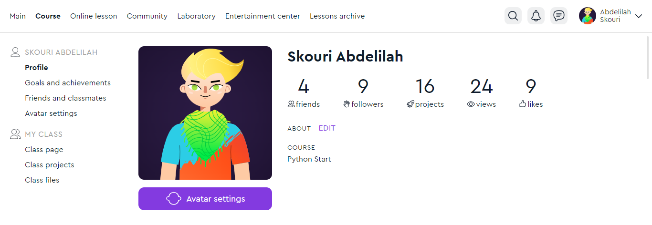
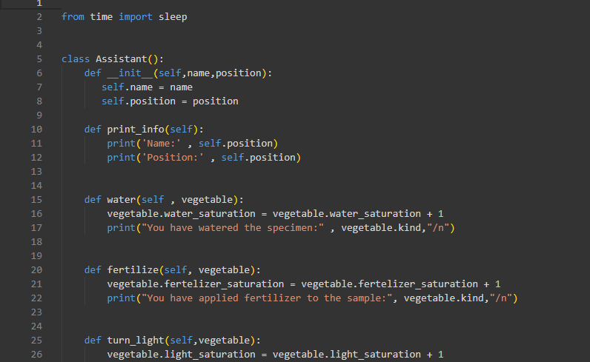

<NAME OF THE PROJECT>
AGRI SMART
Platform
IBRAHIM HASSAN
Programming Language
Script/ Code

Slide 4
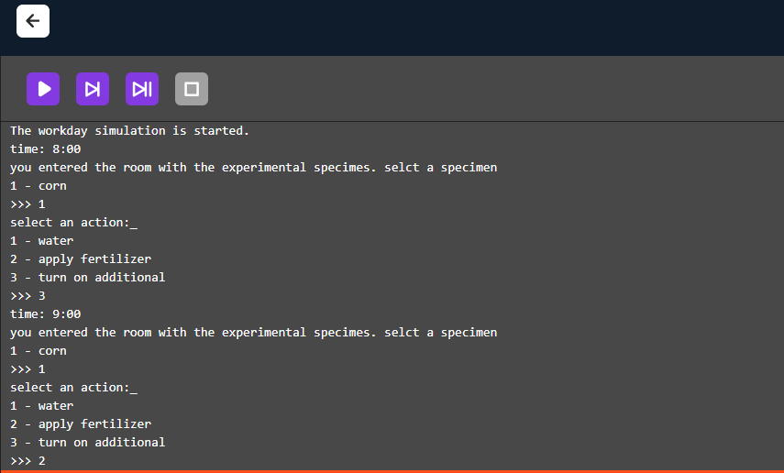
<NAME OF THE PROJECT>
IBRAHIM HASSAN
Let’s get a closer look on the platform !

Slide 5



If you are interested you contact me :
<NAME OF THE PROJECT>
abdelilahskouri @gmail.com
IBRAHIM HASSAN
+212 684-924544
@agri_smart

